Slide 1

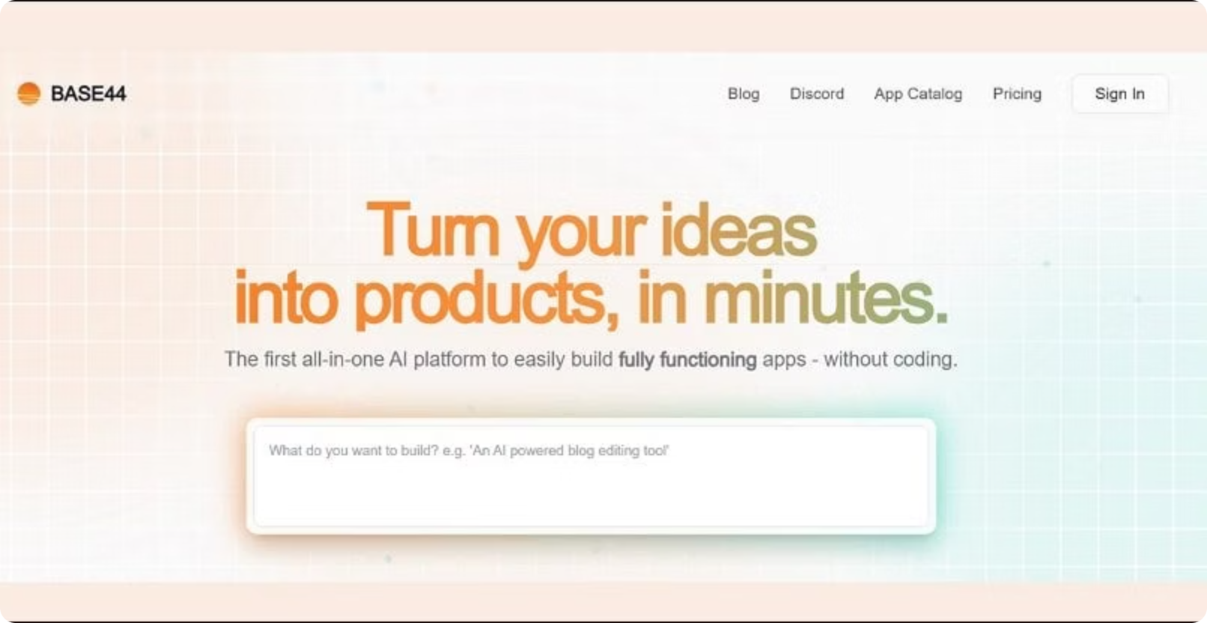

Base44 for Building Lightweight Apps
Hands‑on workshop with Base44.com

Slide 2
Agenda
With Base44, you'll go beyond ideas and create tools people can use.
This session will teach you how to work with Base44 responsibly, confidently, and creatively.
Background and Company
Core Features
Base44 vs Competitors (i.e. Lovable, Bolt)
Pricing Overview and Usage Limitations
Recommendations - For which use-cases to use and when prefered not to

Slide 3
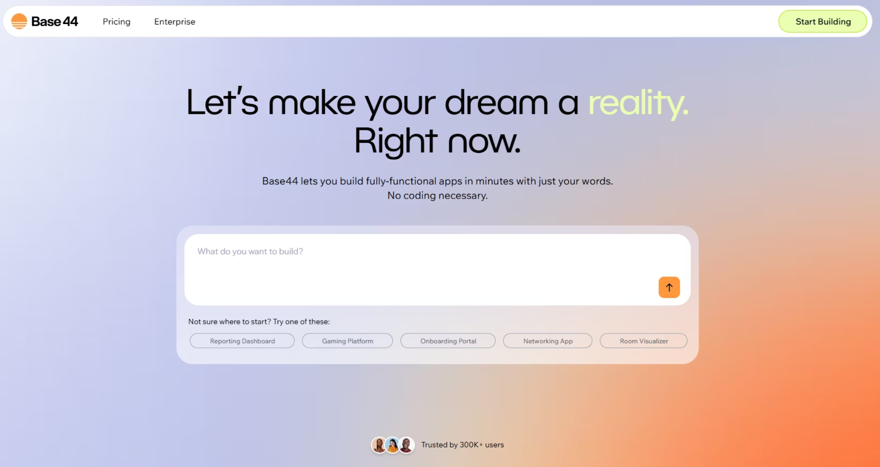
Base44 is an AI-powered platform that lets you turn any idea into a fully-functional custom app, without the need for any coding experience.
Israeli proud..! @Maor Shlomo

Slide 4
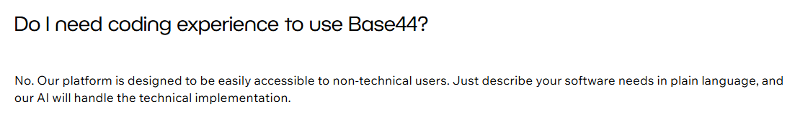
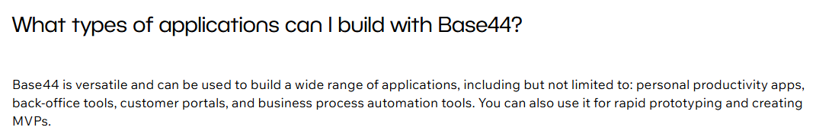
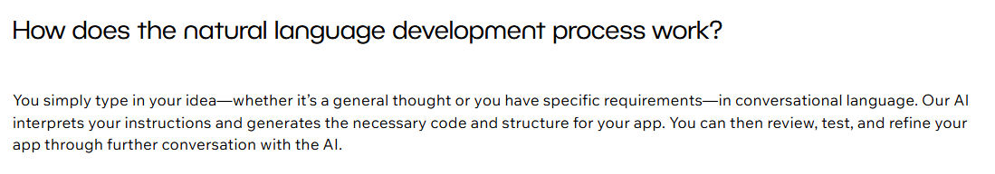
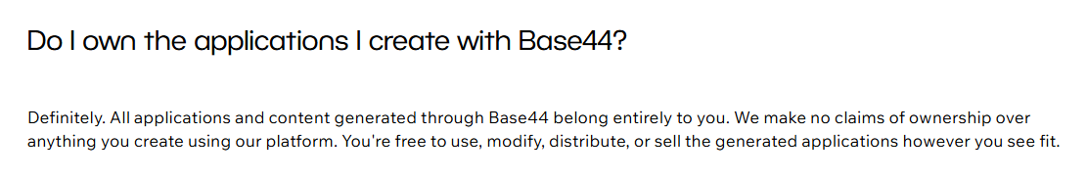
Common Questions

Slide 5
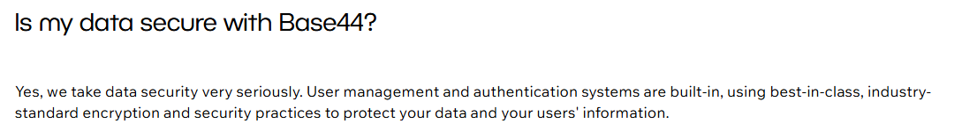
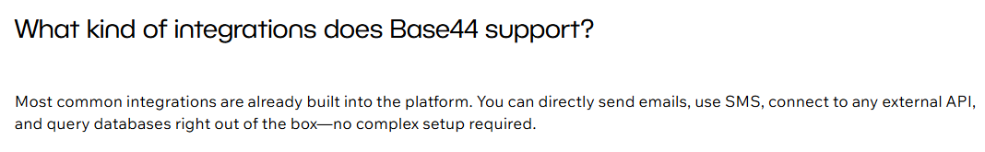
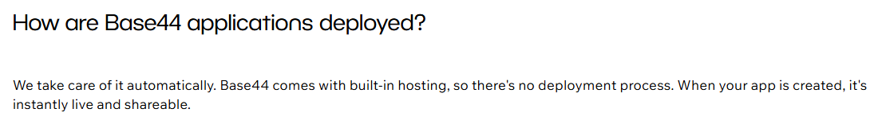
Common Questions

Slide 6



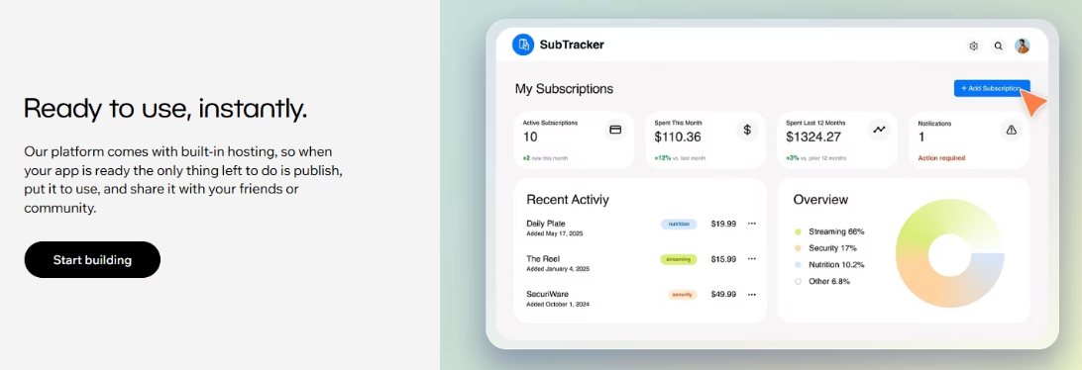
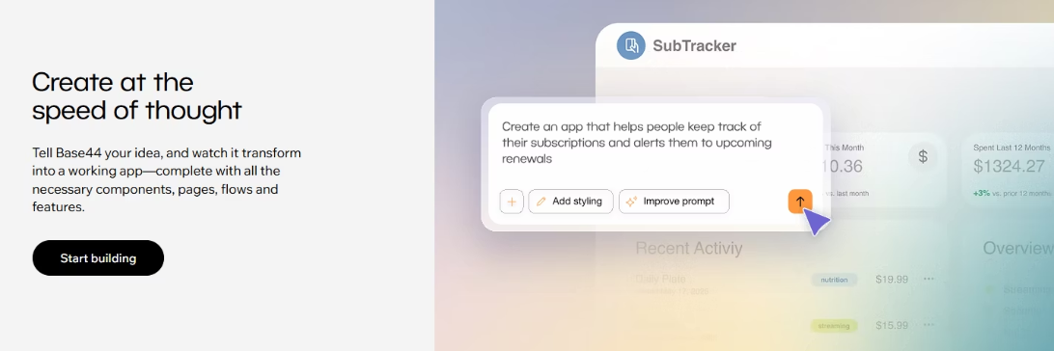
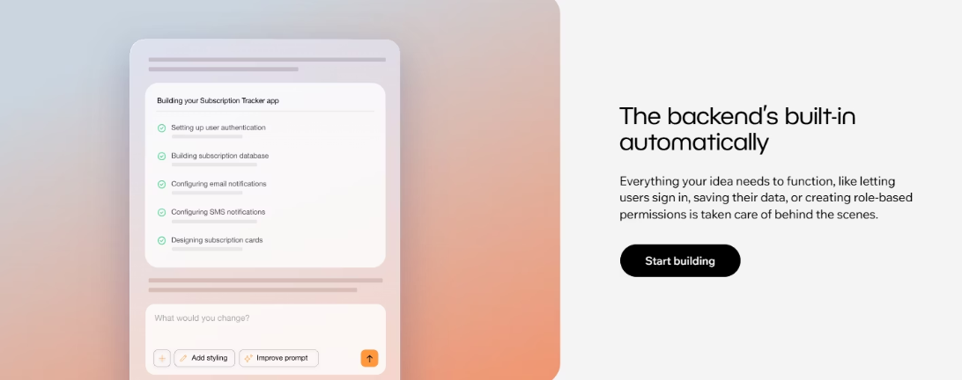
Core Features of Base44
Natural Language Input
Full-Stack Generation
Instant Deployment
Describe your app idea conversationally, just as you would explain it to a colleague.
Automatically creates UI components, backend logic, database structures, and workflows without requiring you to write a single line of code.
Apps are hosted and deployed immediately

Slide 7

Technical Architecture & Integrations
The platform includes everything required for a functional application:
Structured and customized database
Secure user authentication system
Hosting services and automatic deployment
Advanced analytics tools
Integration with email services
Support for maps and location services
The main advantage of the system is that it eliminates the need for complex integrations with external services.

Slide 8
Base44 vs Competitors
Base44
Lovable, Bolt
Data Storage
Internal, fully managed
External (e.g., Supabase API)
Permission Management
Simple UI-based controls via the Dashboard
Often requires manual configuration
Code Management
Inside the platform, easy export to GitHub
via GitHub
Authentication
Google sign-in by default
Manual setup required
Hosting
Inside the platform
External hosting services (i.e. Netlify)
Base44 prioritizes simplicity and speed, presenting the first all-in-one application builder tool, making it ideal for quick launches and non-technical users while maintaining essential functionality.

Slide 9


Strategic Growth: Wix Acquisition (June 2025)
$80 Million Acquisition
Wix acquired Base44 for approximately $80 million plus performance-based earn-outs, signaling strong confidence in the platform's value and future growth potential.
Strategic Integration
Base44 continues as a distinct product within the Wix portfolio while enhancing Wix's suite of AI-powered creation tools for businesses and individuals.
Accelerated Vision
The acquisition fast-tracks Base44's mission to democratize software creation through intent-driven, code-free digital experiences.

Slide 10
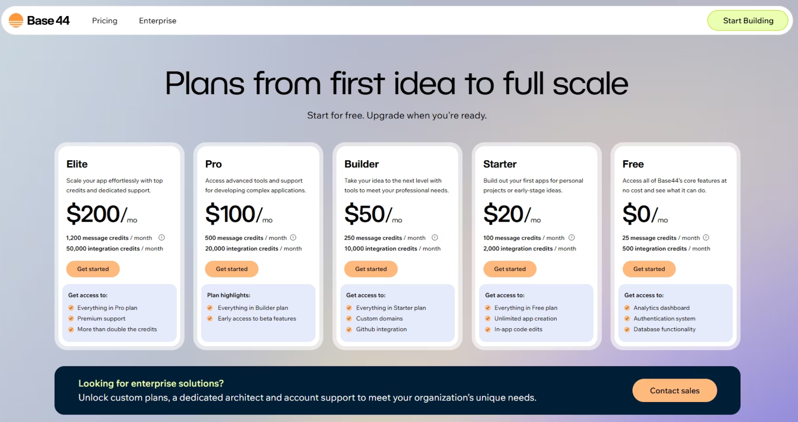
Pricing and Usage Limitations

Slide 11
Practical Uses and Recommendations for Base44
Base44 platform offers versatile applications across various fields.
Solutions for Individuals
Tools for Small and Medium Businesses
Create personalized budget management apps, goal trackers, and trip planners with expense tracking.
Develop customer portals with order tracking, inventory management tools, and employee time systems.
Build digital catalogs for collections and recipe/menu management systems.
Case study: A marketing agency's customer portal with task tracking and analytics saved $8,000 annually on SaaS subscriptions.
Create customized management dashboards tailored to specific business needs.
Explore common questions when using Base44 - https://docs.base44.com/

Slide 12
When Not to Use...
Despite its benefits, consider alternatives in these scenarios:
Projects Requiring Full Control
Massive Enterprise Applications
Limited Long-Term Budgets
Experienced developers needing complete code control prefer tools like Cursor. Applications requiring advanced performance optimizations need custom development.
Systems with thousands of users and strict security requirements need enterprise solutions. Complex integrations with legacy systems may prove challenging.
Organizations avoiding recurring payments should seek one-time solutions. Notification features may incur unexpected costs.

Slide 13
Today
Tour of the Base44 interface.
How to build a working app with user input, saved data, and dynamic screens.
How to use flows (logic engine), the database, and API integrations.
Build a full app step-by-step together with your instructor.

Slide 14
Base44 Demonstration
“FixMe” app - Service Call Management System
"FormFlow" app – Build-Your-Own Form and Analyze Submissions

